Slide 1




GRAB A VISCAN
ANYTHING, ANYTIME, ANYWHERE
GRAB
A
VISCAN
Francis Mark Baguion
BSCS - II
APPLICATION DEVELOPMENT
EVENT DRIVEN PROGRAMMING

Slide 2
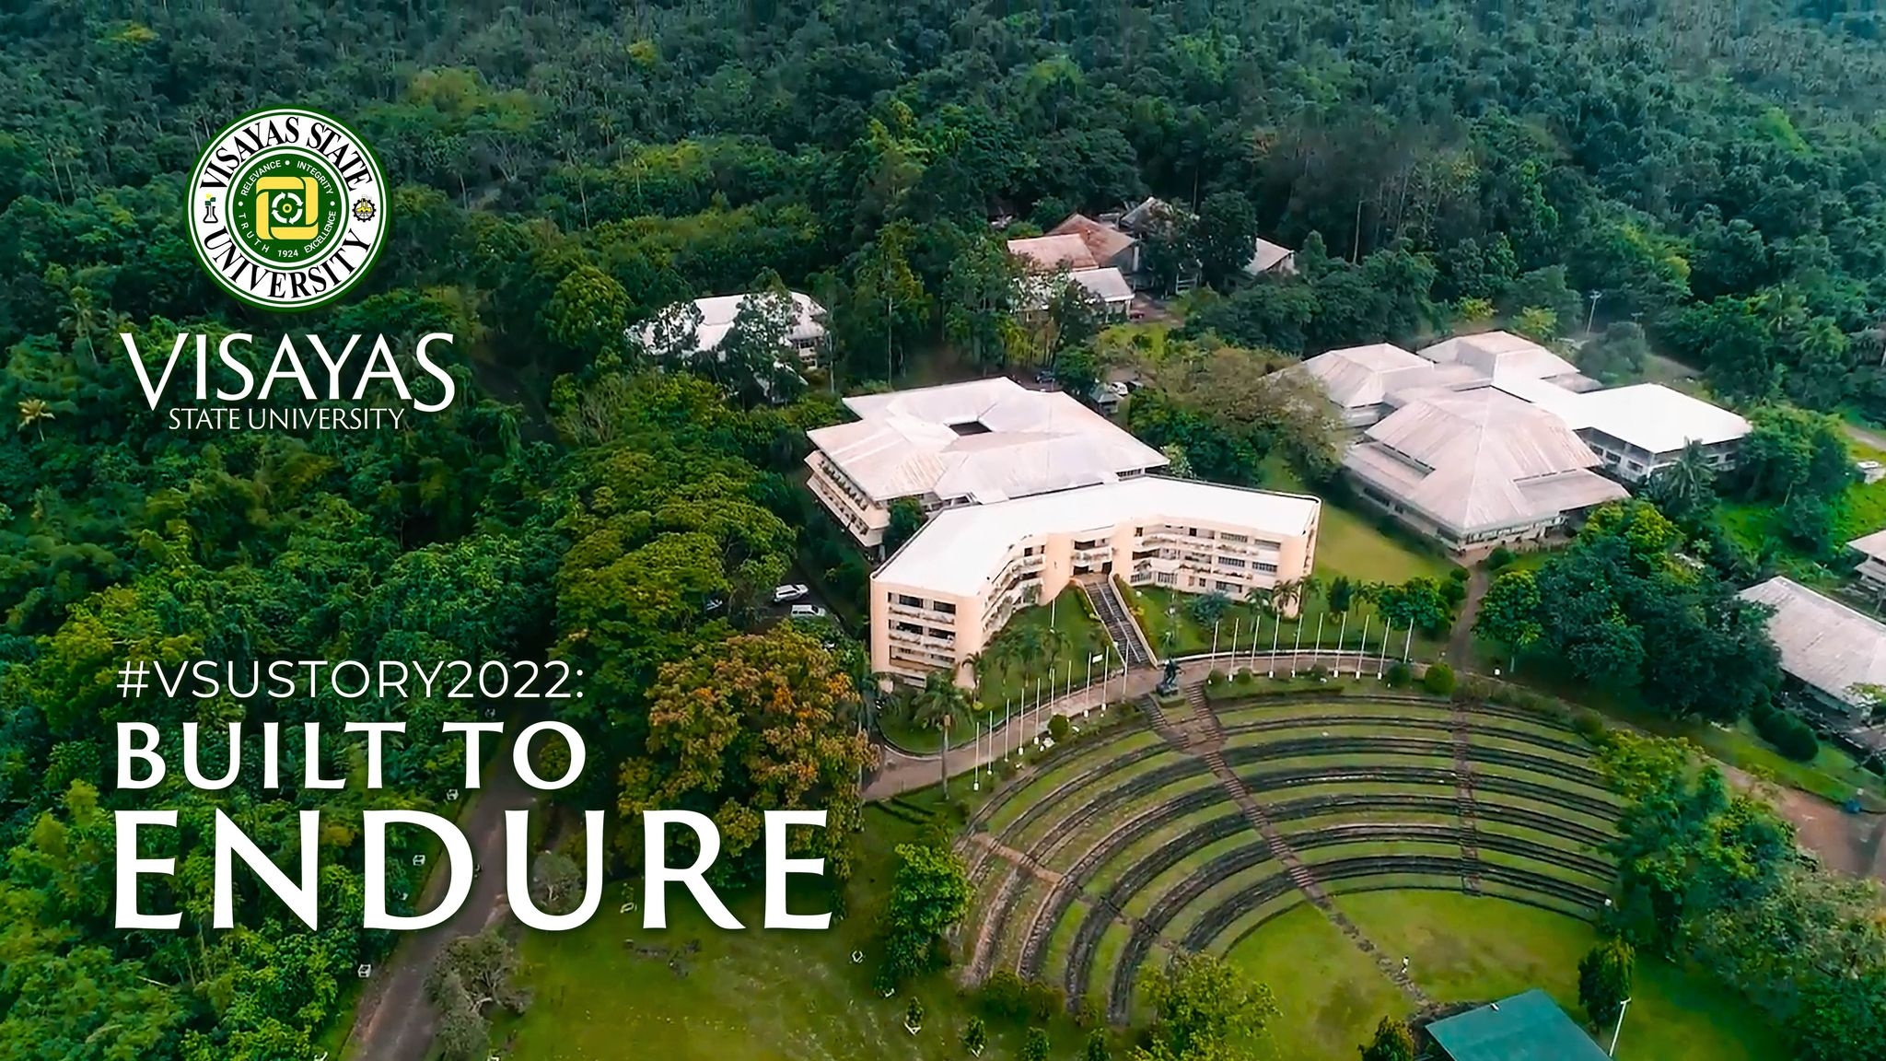
Known as the second widest campus in the Philippines in terms of land area.
Campus Grounds - 61.6 ha.
Only less than 30% owns a personal vehicle
GRAB A VISCAN
ANYTHING, ANYTIME, ANYWHERE

Slide 3


Proposed Solution
Grab A Viscan - A two-way delivery application that connects the user for delivery and errand.
Offers delivery services
Income generating application
Fast transaction
Connects the community
Convenient

Slide 4







Project Overview
Income Generation through delivery
Delivery Fee Optimization
Marketing & Promotions
Delivery and errand request
Runner earning through errand and request completion.
dynamic pricing model that adjusts delivery fees based on factors such as demand (user defined)
Partner with restaurants and stores to offer targeted promotions and advertising within the app, generating revenue streams.
Customers can post requests for deliveries (food, belongings, essentials, etc.) or errands (pick-up, drop-off items, etc.). They can specify details like location and items.

Slide 5


GOALS
Become the Go-To Delivery Solution
Connect Users & Businesses
Facilitate a seamless connection between users who need deliveries/errands done and businesses that offer those services.
Establish itself as the preferred platform for students and other entity inside the campus, seeking on-demand deliveries and errands.

Slide 6









SCOPE OF THE PROJECT
LIMITED ONLY TO VSU
This application only caters to Visayas State University
A GATEWAY OF CONNECTION
The application only connects the people, and does not administer the runner as an employee
F2F Transaction
Transactions are face to face, but can still be up to the user if they opted for a third party payment method.
Two way
User can deliver, or can post request.

Slide 7

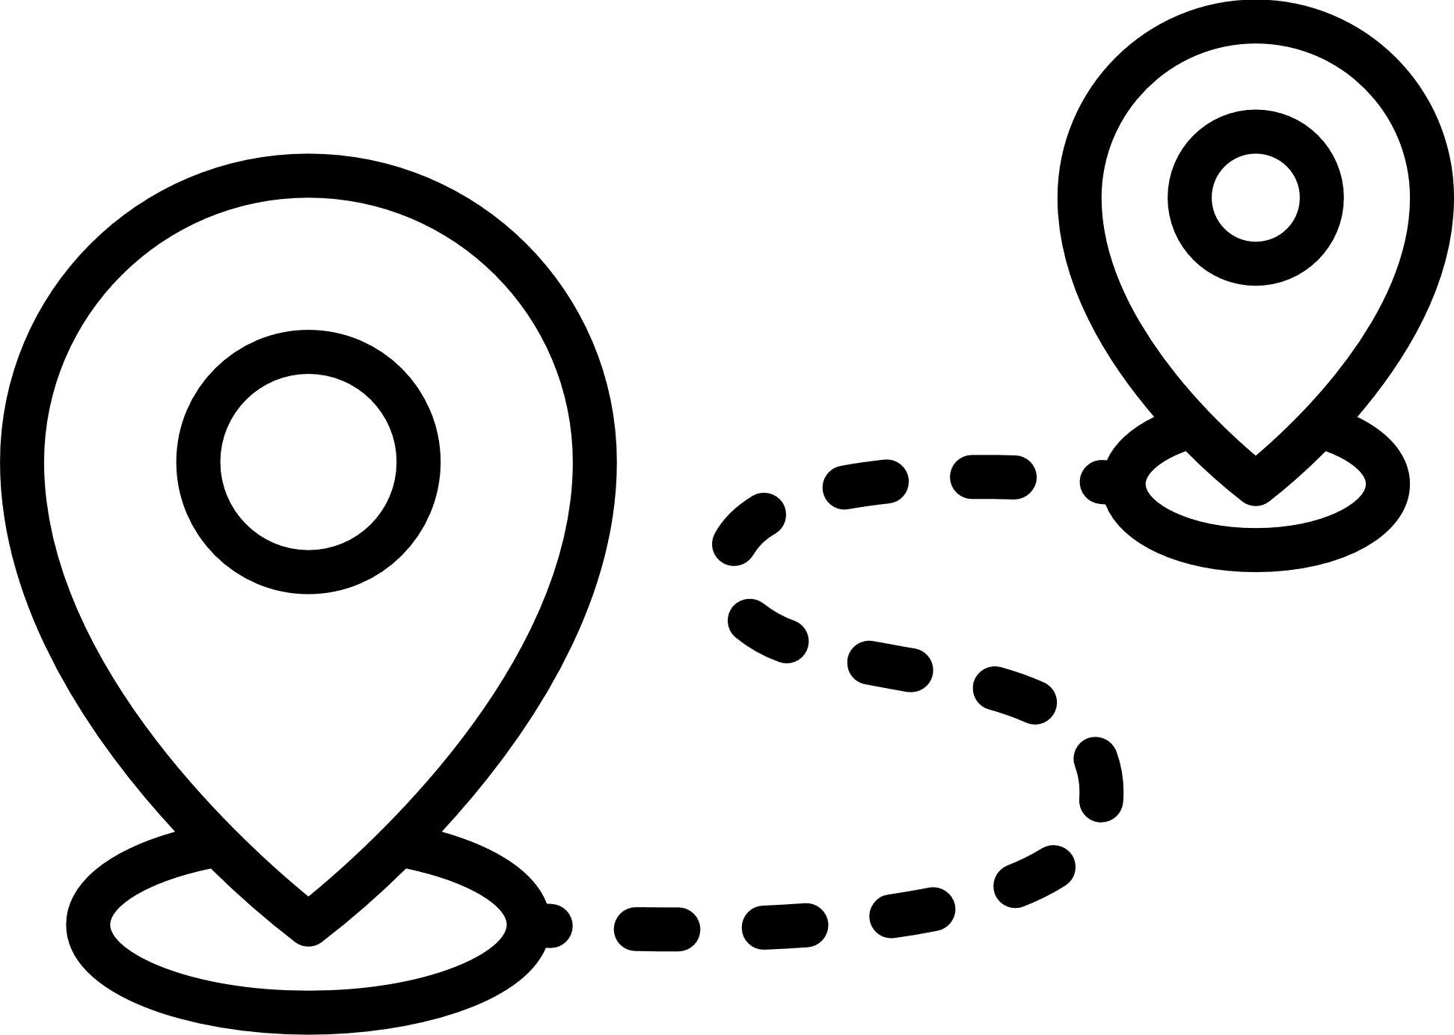


Functional Requirements
User Management
Delivery & Errand Management
User registration, login, and profile management for Customers
Customers can post delivery/errand requests with details like location and items. and also take up request to deliver.
Reporting
Order History & Tracking
Generate reports on delivery/errand volumes, and user activity.
Maintain a user history section where customers can easily track past deliveries/errands, repost previous requested items.

Slide 8




System Requirements
User Management
Delivery & Errand Management
Enables the user to register an account
Allows the user to update account information such as user info and profile picture.
Allows the user to recover forgotten password through email OTP confirmation.
Let the user post a request
Let the user take up delivery/errands
Allows the user to cancel the request if it has not been processed.
Allow the user to edit requests in a limited stage of the delivery process.
Reporting
Order History & Tracking
Allows the user to view the total request
Allows the user to view the total delivered request
Allows the user to view all the completed transaction.
Let the user view all the recent request made
Let the user view all the recent deliveries
Allows the user to repost cancelled or accepted previous request.

Slide 9
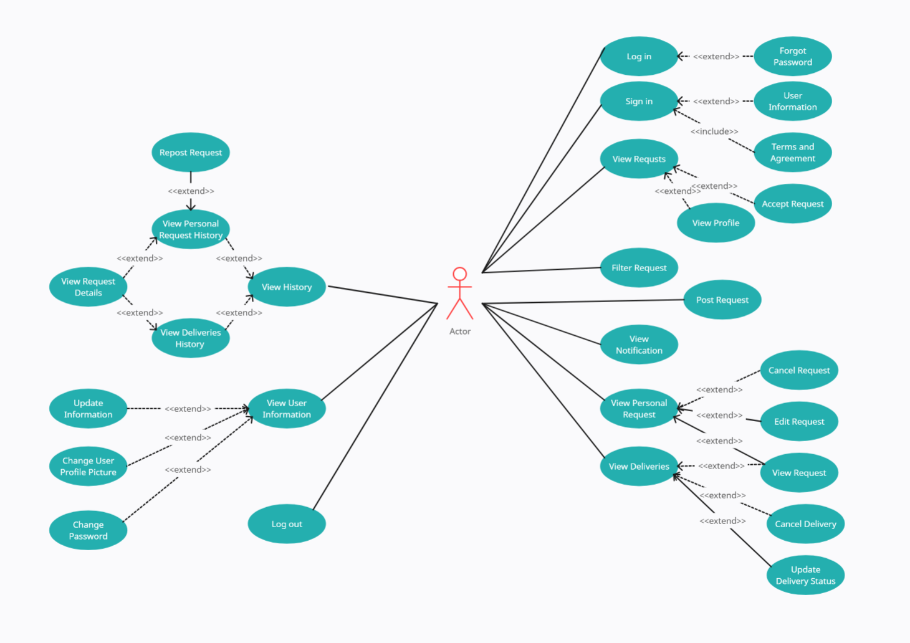

Slide 10


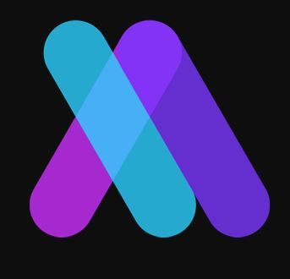
Technology Used
C#
MySQL
Guna UI
Programming Language
Database
Framework

Slide 11
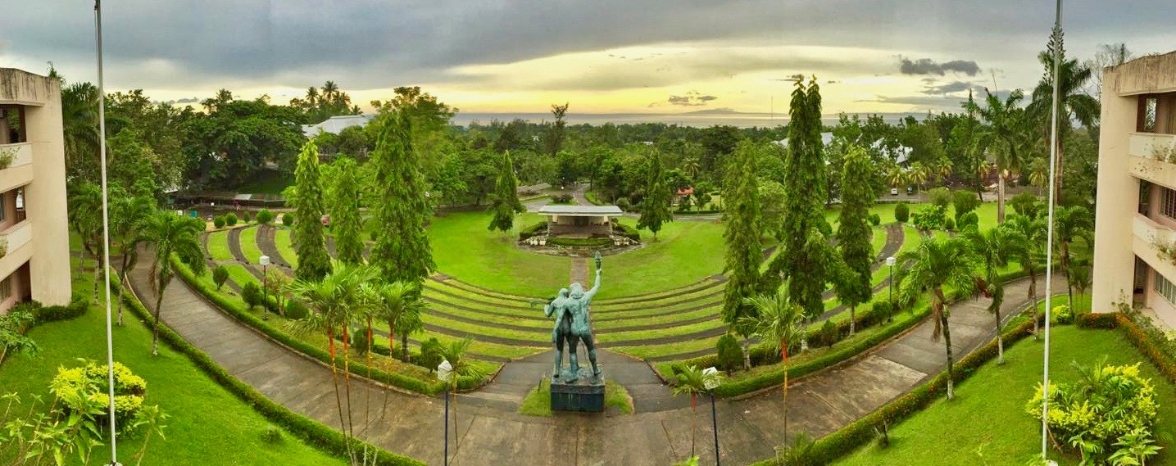
GRAB A VISCAN
ANYTHING, ANYTIME, ANYWHERE
Thank You
For Your Attention

